Slide 1
INTERFACING OF RASPBERRY PI FEEDBACK FROM SWITCH

Slide 2
AIM:
Programming of Raspberry Pi to take feedback from the switch
APPARATUS:
Raspberry Pi with Raspbian Pi OS, LEDs, Resistors, Push button switch, USB
Keyboard, mouse LCD Monitor, HDMI to VGA converter, 5V Power Adapter.

Slide 3
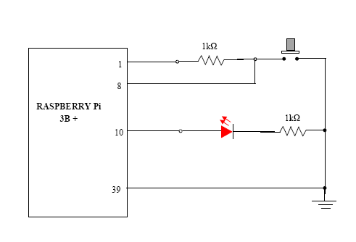
CIRCUIT DIAGRAM:

Slide 4
Procedure:
1. The kit consists of Raspberry Pi 3B+, Power adapter, HDMI to VGA converter cable and PCB with LEDs connected and the 10 pin connector.
2. One LEDs and one switch pair is available.
3. Connect the circuit as shown in the circuit above.
4. Run the program using “run” button in the IDE, it will ask you to save the file. If not saved before, save it with file name extension .py
5. Now press the switch (SW), you will observe LED is glowing. After releasing the switch, the LED turns off.

Slide 5
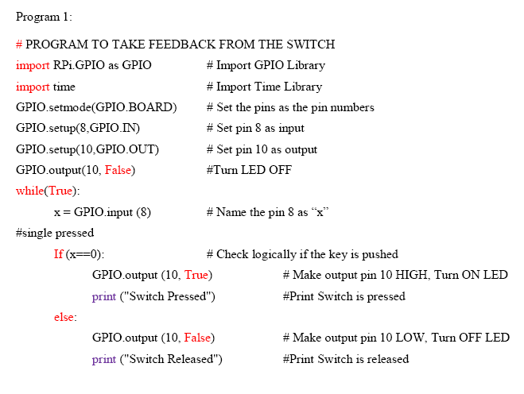

Slide 6
ASSIGNMENT
1.Explain the working of the setup?
2. Modify the program to interface second switch and LED such that when 2nd switch is released,2nd LED will be ON and when switch is pressed LED should be OFF.

